Slide 1


AI Generated Content Detection
Gillian Tatreau
March 2024

Slide 2
What is AI-Generated Content?
Generative AI has existed since the 1960s
Content generated by an AI typically focuses on word relevancy to a prompt
Text will be classified as AI or human-generated using predictive machine learning algorithms

Slide 3
Data Explanation
Data originated on Kaggle
Contains text from approximately 500,000 essays
Data preparation
Rows with text that contained no punctuation were removed
number_sentences and words_per_sentence variables created

Slide 4
Methods
EDA
Models built based on sentence length and variability (number_sentences and words_per_sentence variables) or TF-IDF
Algorithms used: logistic regression models, random forest classifiers, naïve Bayes classifiers, and support vector classification models
Evaluation metrics: accuracy, recall, and precision scores, and confusion matrix

Slide 5
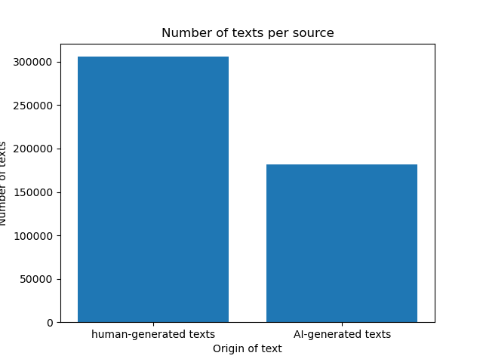
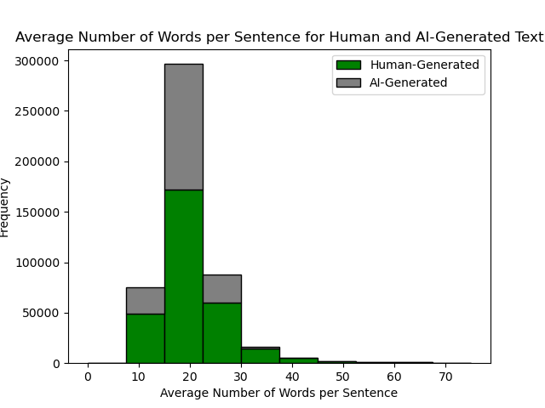
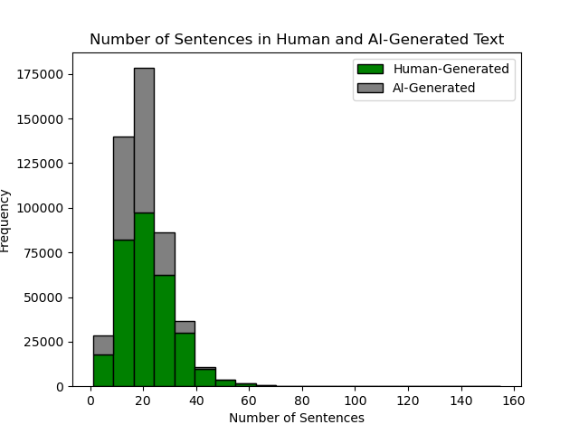
EDA Results

Slide 6
Models Based on Sentence Length and Variability
Data prep: standardized data with StandardScaler()
Dummy accuracy: 0.626 | Train Accuracy | Test Accuracy
Logistic regression | 0.5984 | 0.5964
Naïve Bayes | 0.5648 | 0.5639
Random Forest | 0.7211 | 0.7022
Support Vector Classifier | 0.6697 | 0.6662

Slide 7
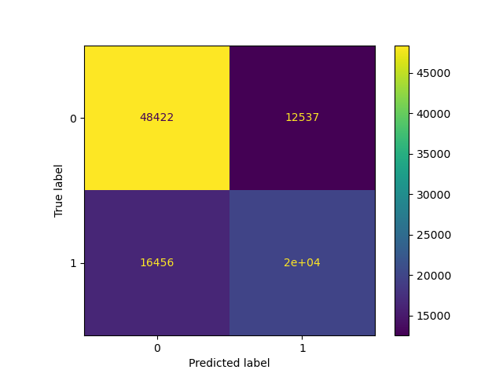
Best Random Forest Model Based on Sentence Length and Variability
Accuracy | 0.7022
Precision | 0.6141
Recall | 0.5481

Slide 8
Models Based on TF-IDF
Data prep: removal of stop words, newline tags, punctuation
Dummy accuracy: 0.626 | Train Accuracy | Test Accuracy | Precision | Recall
Random Forest | 1.0 | 0.9892 | 0.9978 | 0.9735
Support Vector | 0.9986 | 0.9785 | 0.9819 | 0.9631
Naïve Bayes | 0.9452 | 0.9372 | 0.9894 | 0.8423

Slide 9
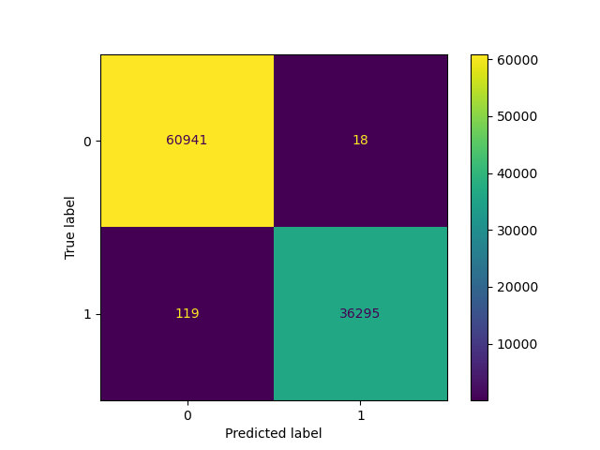
Best Random Forest Model Based on TF-IDF
Accuracy | 0.99857
Precision | 0.99961
Recall | 0.99657

Slide 10
Conclusion
Stylistic differences between AI and human-generated text
Random forest model based on the TF-IDF data is very high performing while the random forest model based on the sentence length data performs only adequately
Assumptions
Text all in English
Essays collected ethically
Ethical Assessment
Possible misuse of AI-generated text in academic and professional settings
Recommendations
Large language model with perplexity analysis

Slide 11
References
Gerami, S. (2024, January 10). Ai vs human text. Kaggle. https://www.kaggle.com/datasets/shanegerami/ai-vs-human-text/data
Hetler, A. (2023, September 21). Pros and cons of ai-generated content: TechTarget. WhatIs? https://www.techtarget.com/whatis/feature/Pros-and-cons-of-AI-generated-content
Matani, D. (2023, September 27). Challenges of detecting AI-generated text. Medium. https://towardsdatascience.com/challenges-of-detecting-ai-generated-text-6d85bf779448
White, M. (2023, July 8). A brief history of generative AI. Medium. https://matthewdwhite.medium.com/a-brief-history-of-generative-ai-cb1837e67106

